Slide 1

Government
As the government creates new laws and regulation to allow for reopening, the government needs to also have an effective way of enforcing these new rules.
I will cover:
Effectiveness of current restaurant inspections at improving sanitation
High risk areas for reopening
Source: https://www.ncbi.nlm.nih.gov/pmc/articles/PMC1997248/

Slide 2
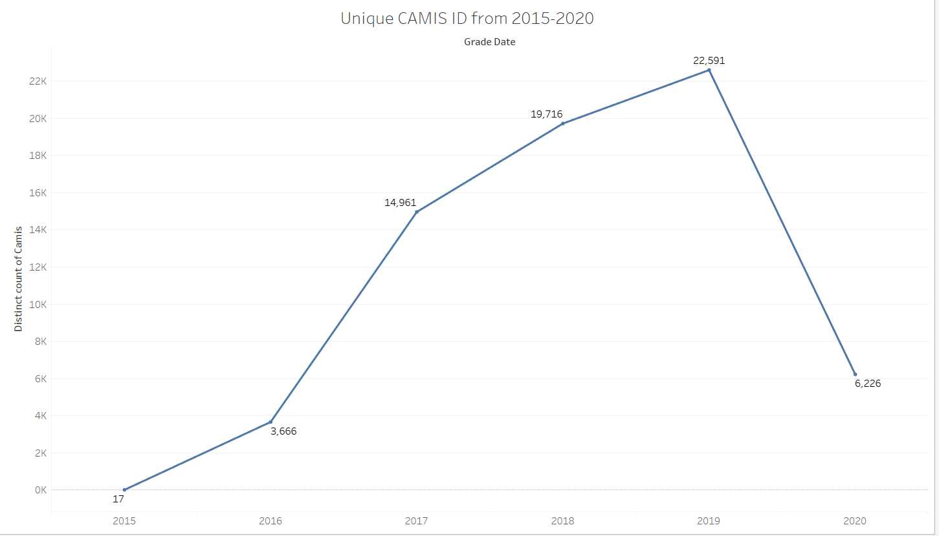
Brief Look at How Many Restaurants Were Inspected
Notes:
sources consistent font and size

Slide 3
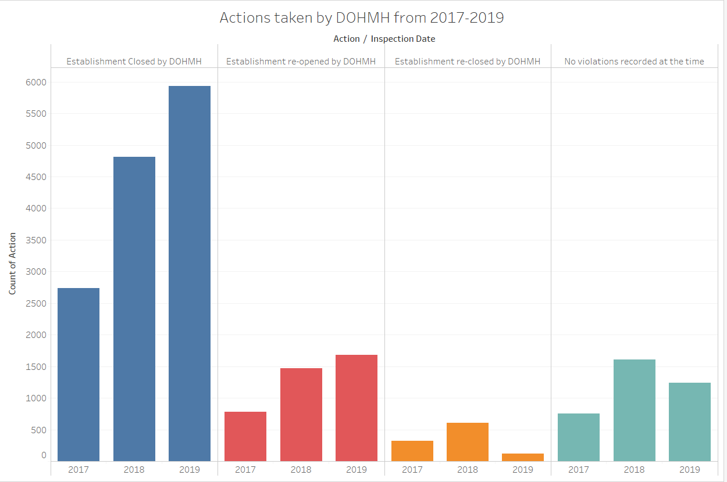
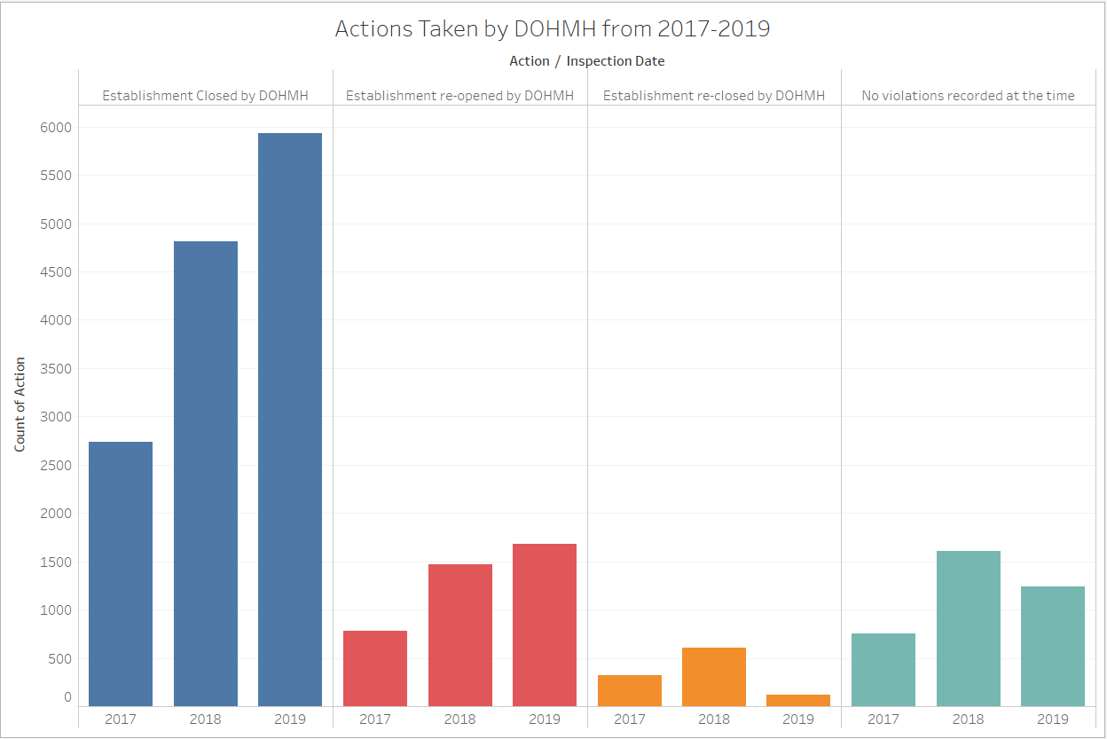
Notes:
violation part time

Slide 4
NYC Council Districts
NYC council districts play an important part in how the city handles reopening. Committees include Committee on Sanitation and Solid Waste Management and the Committee on Health.
Source: https://council.nyc.gov/about/

Slide 5
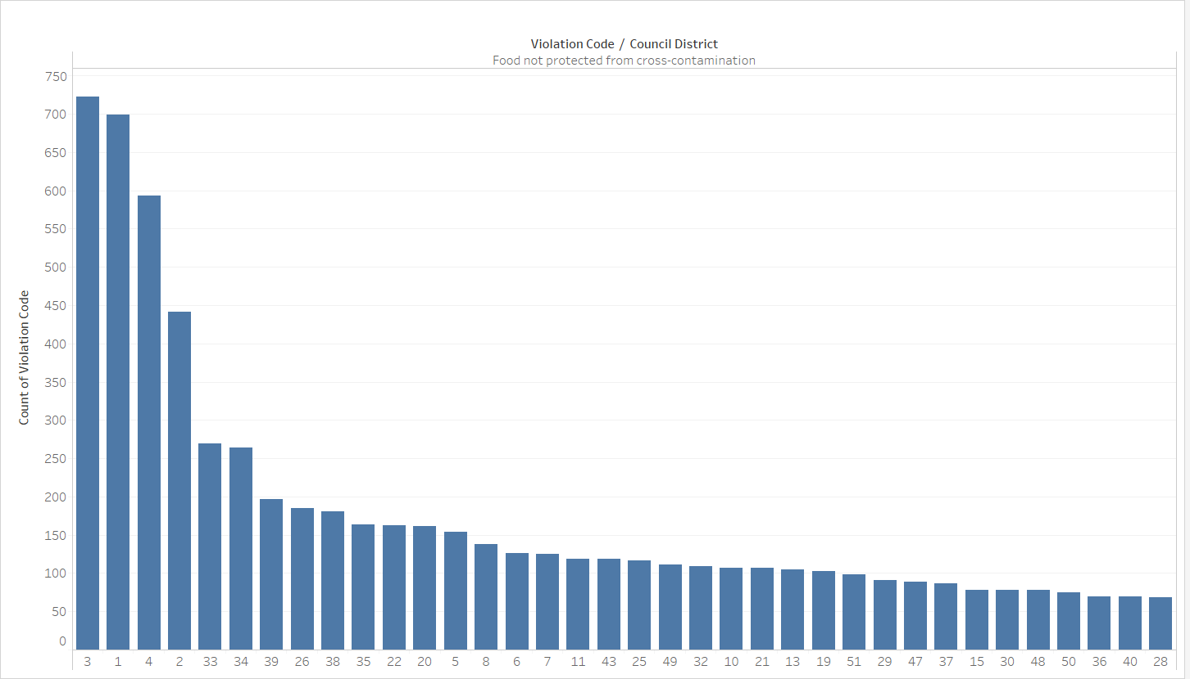
Top 8 violators are districts 1,2,3,4,26,33,34 and 39 (not in order).

Slide 6
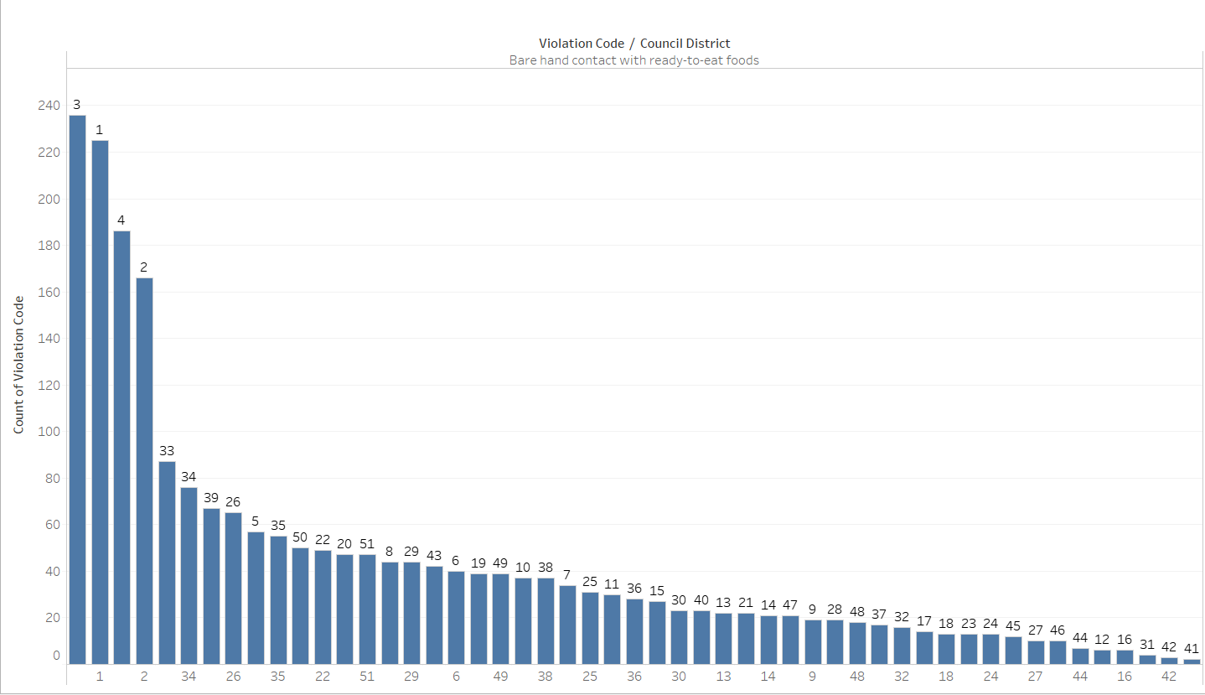
Top 8 violators are districts 1,2,3,4,26,33,34 and 39 (not in order).

Slide 7
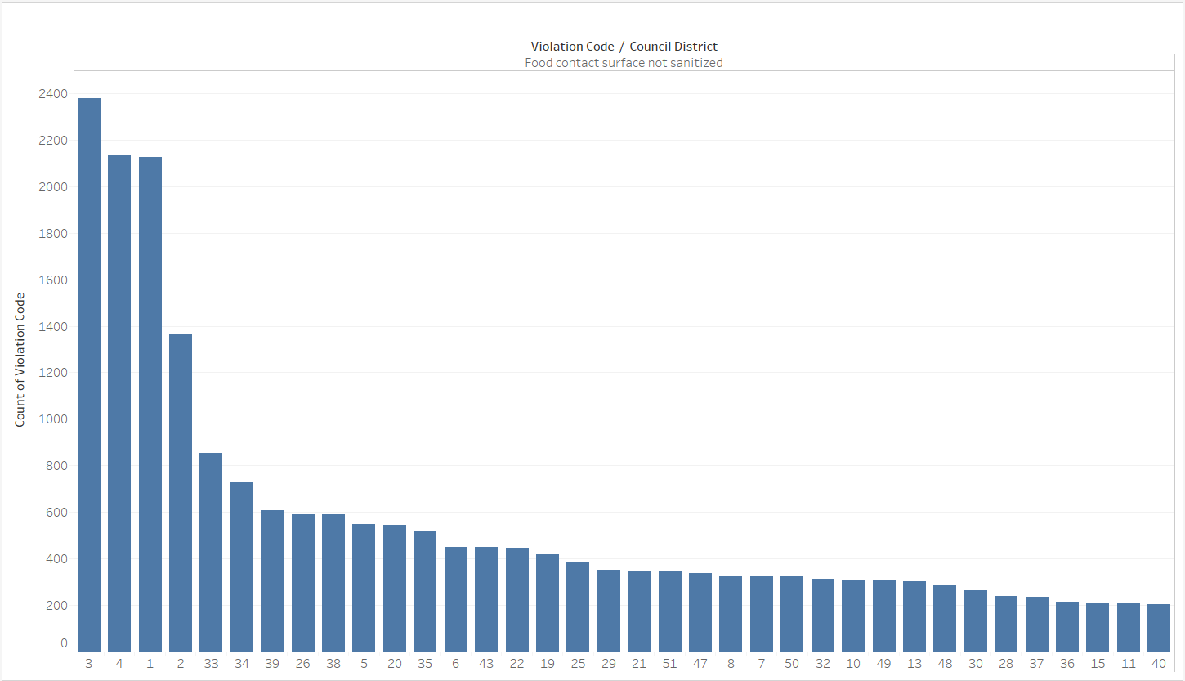
Top 8 violators are districts 1,2,3,4,26,33,34 and 39 (not in order)

Slide 8
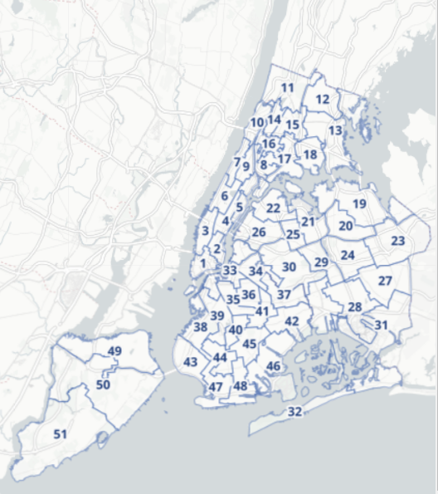
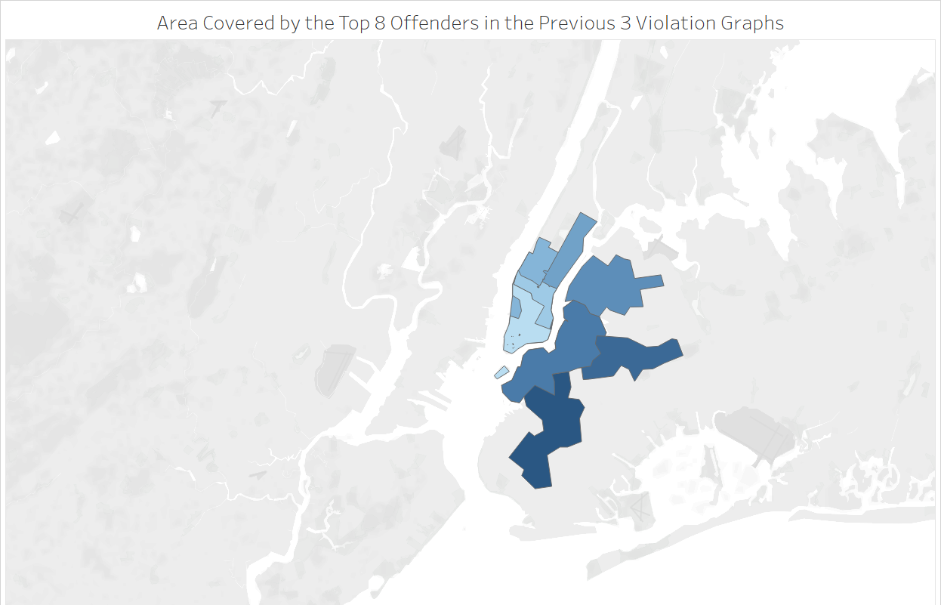
Here are New York City’s Council Districts
Source: https://council.nyc.gov/about/
Notes:
blurry fix please and add title

Slide 9
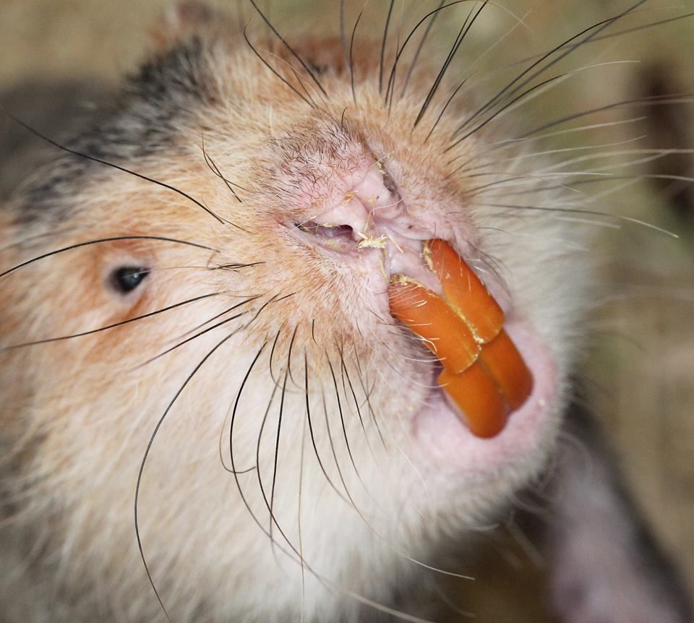
Rats!
Rats are one of the most dangerous carriers of diseases, capable of carrying over 35 diseases. Certain rat species are known carriers of Covid-19 such as bamboo rats, but it is currently unknown if rats can transmit the disease to humans or other species of rats (it is confirmed that rats can carry and transmit other forms of coronavirus).
Experts believe that Covid-19 is using rats as a intermediary host as it mutates to infect humans.
source: https://www.automatictrap.com/blogs/news/can-rats-carry-coronavirus
Notes:
add picture next slide or u do u mean a picture vs a graph? add picture here consistent font NOOOOOOOOOOO Diseases can also be transferred indirectly by ticks, fleas, and mites that live on infected rats.

Slide 10
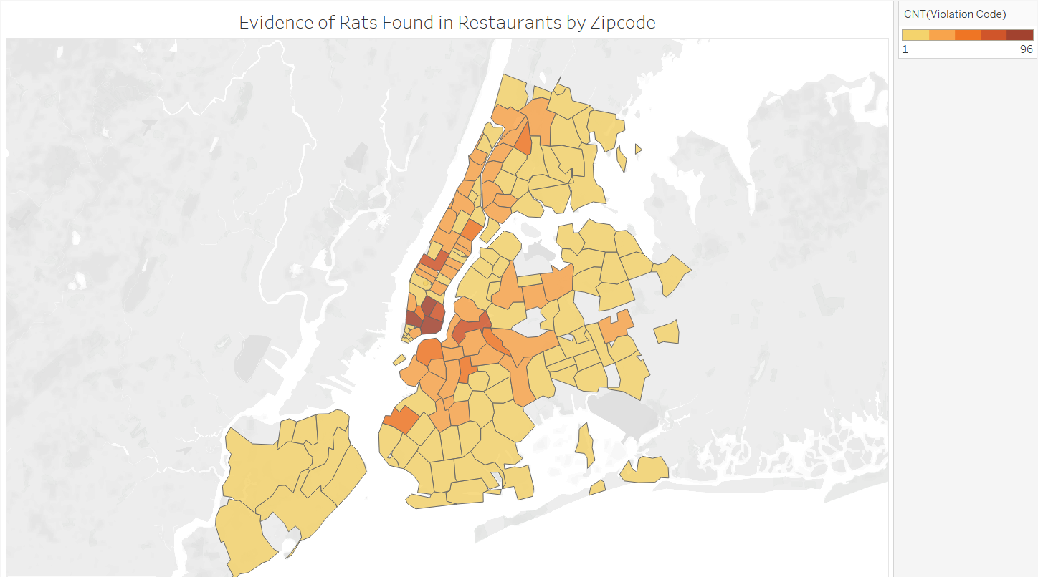
A Bird’s Eye View on Rats
Soho, Lower Manhattan, Lower East Side, Sunset Park, and Williamsburg are the top offenders of having mice in their restaurants.
This is a huge concern because active restaurants produce a large amount of garbage, thus attracting rats back into areas where people are going to be gathering.
Rat cannibalism and infanticide has been reported by news agencies as rats struggle to compete for food.
Source:https://www.nbcnews.com/politics/national-security/starving-angry-cannibalistic-america-s-rats-are-getting-desperate-amid-n1180611
Notes:
rats cannibalism add title and merge center (consistent font) title should be bigger than rest

